Slide 1
changing
Real Food - Real Hope
direction
Healthy Ageing
The Lifestyle Options
Jeremy Martin
Associate with Think Healthy Me

Slide 2
This presentation is for information only. It is not medical advice. Please discuss any dietary changes with your doctor, especially when on medications for type 2 diabetes.
Adapting diabetes medication for low carbohydrate management of type 2 diabetes: a practical guide.
Campbell Murdoch, David Unwin, David Cavan, Mark Cucuzzella and Mahendra Patel
https://bjgp.org/content/69/684/360
and
https://www.ncbi.nlm.nih.gov/pmc/articles/PMC8380766/

Slide 3
Diseases and conditions mainly associated with aging
A metabolic connection with the major age related diseases
Dietary solutions are the precursor to other lifestyle solutions

Slide 4
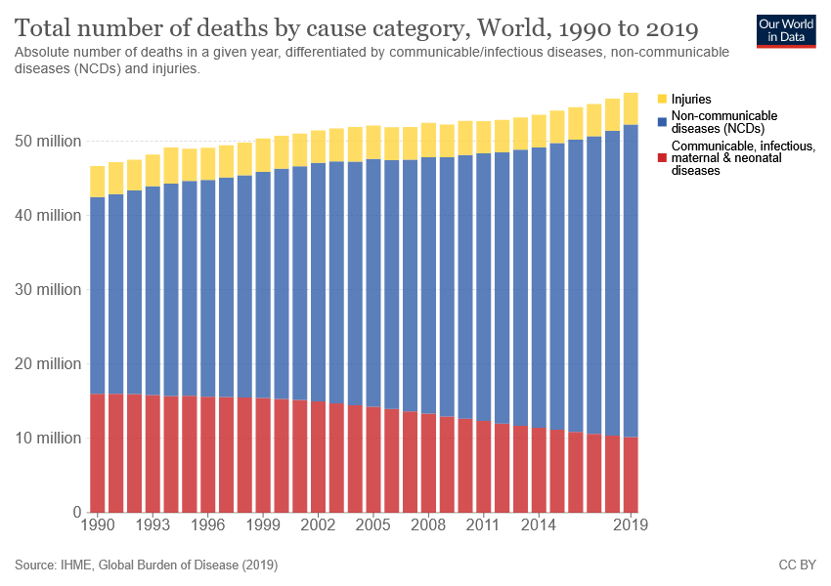
Injuries
Non-communicable
Communicable
https://ourworldindata.org/causes-of-death

Slide 5
Projections for over 65s
2035 millions
2015 millions
2.8x
https://academic.oup.com/ageing/article/47/3/374/4815738?login=false

Slide 6
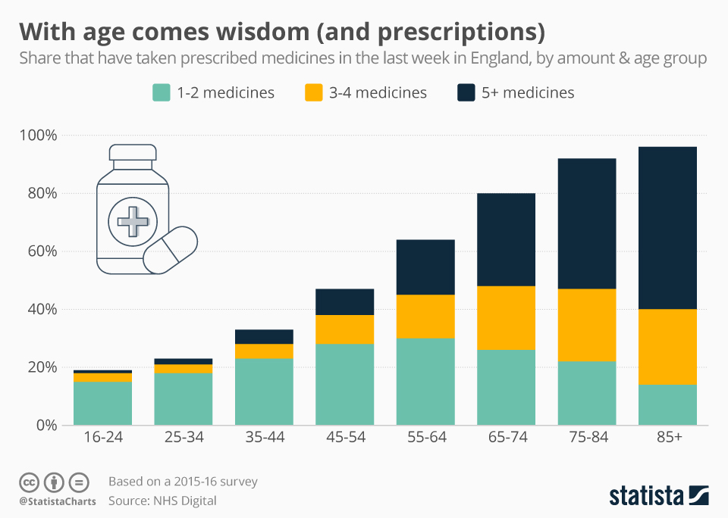
https://www.statista.com/chart/20056/prescription-medicine-by-age-group-england/

Slide 7
Hip fractures in UK
Hip fracture is the commonest cause of injury related death
10% mortality at one month
30% mortality at one year.
75,000 hip fractures annually
75% of those suffering such fractures are female
If you fall, you want to bend, bounce but not break
https://bmjopenquality.bmj.com/content/3/1/u205006.w2103

Slide 8
The metabolic connection Insulin resistance?

Slide 9
Meeting the challenge of insulin resistance in general practice
‘the conditions most likely caused by high-carbohydrate diets in those with insulin resistance.’ Noakes and Sboros (2017)
‘insulin resistance is the epidemic you may have never heard of’ (Bikman, 2020: 3).
obesity
heart attack
stroke
type-2 diabetes
hypertension
NAFLD
cancer
dementia.
https://www.practicenursing.com/content/comment/meeting-the-challenge-of-insulin-resistance-in-general-practice/

Slide 10
Insulin Resistance?
Primary causes
too much insulin
stress hormones
inflammation
Secondary causes
excessive linoleic acid in vegetable (seed) oils
age
genetics
smoking and pollution
Prof Ben Bikman, Researcher, Brigham Young University

Slide 11
Diseases of lifestyle - Cancer
2.8x
This data broadly agrees with a projection made from data from cancerdata.nhs.uk
2035
2015
Millions over 65
https://pubmed.ncbi.nlm.nih.gov/34681797/
https://onlinelibrary.wiley.com/doi/full/10.1111/j.1349-7006.2010.01521.x

Slide 12
Diseases of lifestyle - Cancer
95% of cancers are triggered by environmental or behavioural factors
5% by genetics
People with type 2 diabetes have twice the risk of developing certain cancers

Slide 13
Diseases of Lifestyle Heart Disease
Type 2 diabetes is caused by having too much insulin, and “too much insulin” is insulin resistance
There is no single variable more relevant to heart disease than insulin resistance.

Slide 14
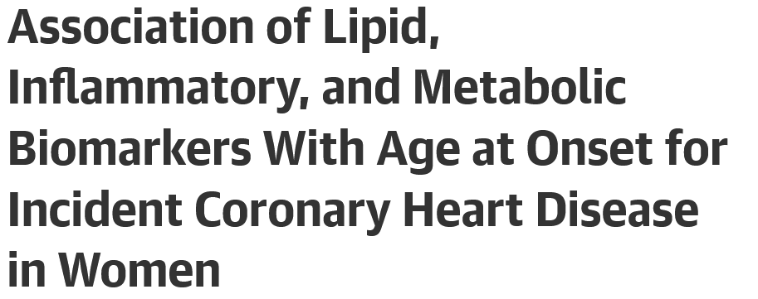
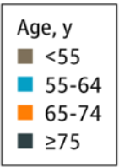
https://jamanetwork.com/journals/jamacardiology/fullarticle/2775559

Slide 15
Diseases of lifestyle - Osteoarthritis
People with insulin resistance …. have reduced bone strength and are much more likely to have fractures
Osteoarthritis, once considered a disease of excessive wear and tear, is increasingly being considered a metabolic disease
https://www.ncbi.nlm.nih.gov/pmc/articles/PMC8692765/

Slide 16
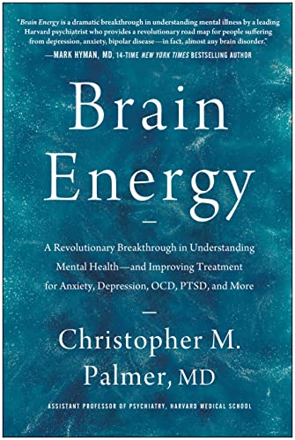
Mental illness – a metabolic disease
All mental disorders are metabolic disorders of the brain
Those with serious mental disorders like chronic depression, bipolar disorder, schizophrenia have much higher rates of obesity, diabetes, cardiovascular disease.
Children with the highest levels of insulin resistance at age 9 were 5 times more likely to develop severe mental illness
https://www.youtube.com/watch?v=bE2G4ULiRFE

Slide 17
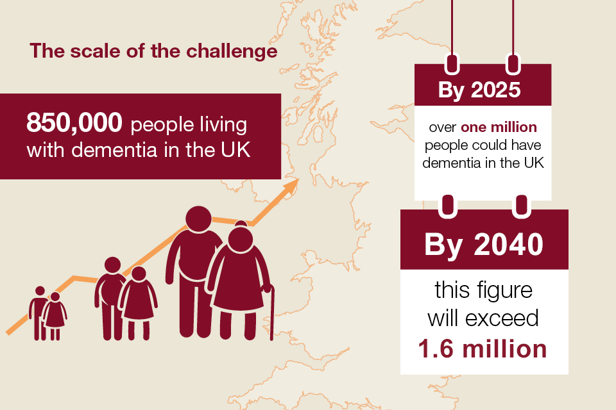
Diseases of lifestyle - Dementia
https://www.gov.uk/government/publications/dementia-applying-all-our-health/dementia-applying-all-our-health

Slide 18
Diseases of lifestyle - Alzheimer’s
13 November 2018
The key intersection among diabetes, obesity, and dementia is insulin resistance, which has recently been shown to develop in Alzheimer's disease (AD) brains.
Here we review encouraging data indicating the potential of targeting impaired insulin signalling with antidiabetic drugs to treat dementia.
lifestyle changes
https://www.frontiersin.org/articles/10.3389/fnins.2018.00830/full

Slide 19
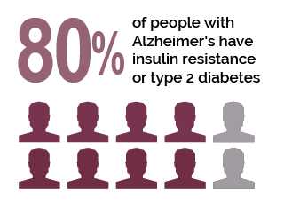
Insulin resistance of the body is type 2 diabetes;
Insulin resistance of the brain is type 3 diabetes.
Researchers have found that Alzheimer’s Disease is preceded by decades of gradually worsening glucose hypometabolism.
Hypometabolism, characterized by decreased brain glucose usage, is a common feature of many neurodegenerative diseases
https://www.psychologytoday.com/us/blog/diagnosis-diet/201609/avoiding-alzheimer-s-disease-could-be-easier-you-think

Slide 20
What is insulin resistance?

Slide 21
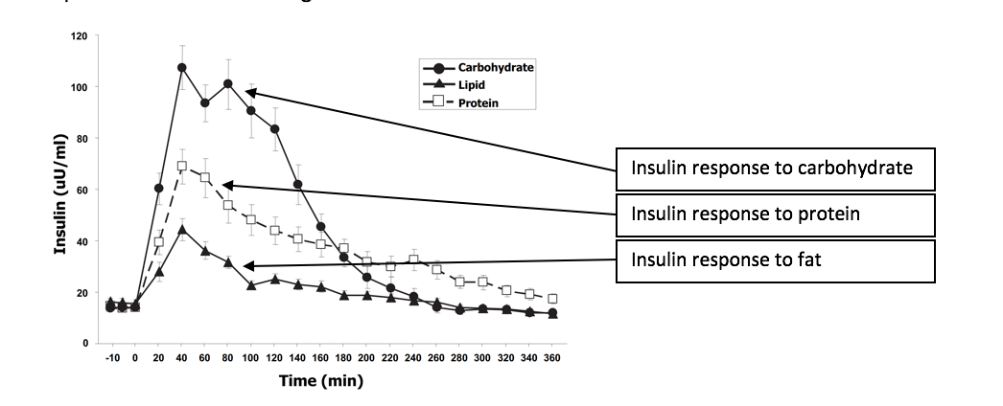
Insulin Responses
Carbohydrates
Protein
Fat
The Journal of Clinical Endocrinology & Metabolism, Volume 93, Issue 5, 1 May 2008, Pages 1971–1979, https://doi.org/10.1210/jc.2007-2289

Slide 22
A cup of cooked rice affects blood glucose as much as 10 teaspoons of table sugar
https://phcuk.org/sugar/

Slide 23
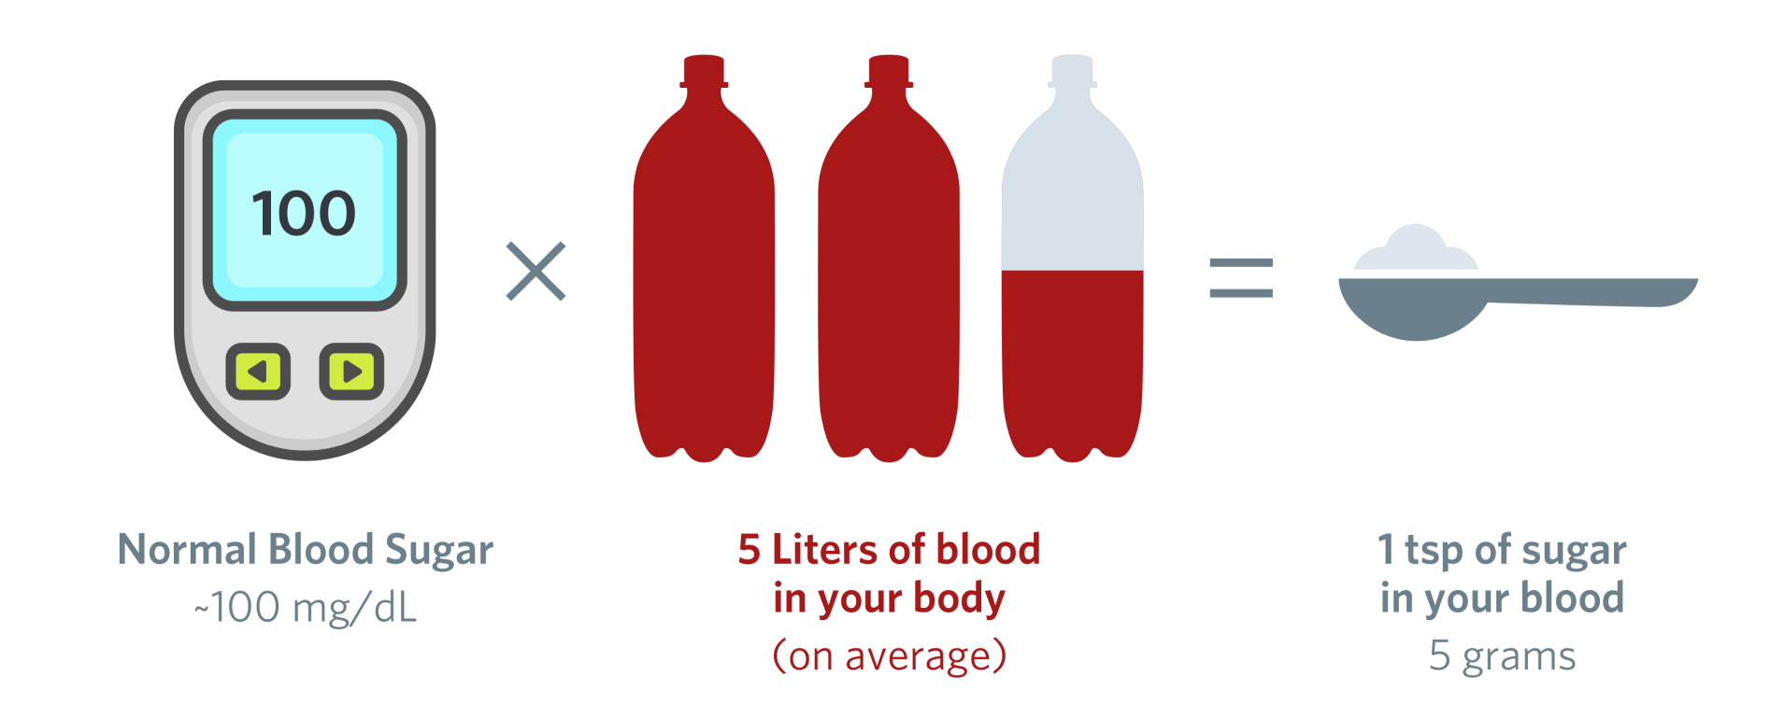
5.6
Normal Blood Glucose
(mmol/L)
5 litres of blood in your body
(on average)
5g of glucose in your blood

Slide 24
https://www.youtube.com/watch?v=CRzPdhO6HOM

Slide 25
Insulin Resistance = high insulin levels (hyperinsulinemia)
What causes Insulin Resistance? Jason Fung
https://www.youtube.com/watch?v=CRzPdhO6HOM

Slide 26
Dietary solutions, lifestyle solutions

Slide 27
“The UK government has set a goal of five more years of healthy life expectancy by 2035. Currently in the UK, on average, women are living for 29 years in poor health and men for 23 years.”
February 2020
“To date the NHS has never really embraced prevention as primary goal, spending less than 5% of its budget on it.”
“Effectively tackling diabetes could prevent millions of people joining the growing ranks of the multi-morbid, frail middle aged and frail elderly.”
https://indd.adobe.com/view/85a7129f-f900-41fa-9a9d-024d13f0aaf5

Slide 28
Protein as we age is essential
Protein protects/grows muscle and bone
Animal protein is superior to plant protein and is ideally suited to our needs
Prioritise protein
How much protein should you eat?
https://www.youtube.com/watch?v=L8XDzB8iMVs
Avoid sugar
Avoid refined grains
Avoid foods that spike blood glucose
Control carbs
https://phcuk.org/sugar/
Don’t fear natural fats
Avoid all seed (vegetable) oils
Animal fats are natural
Saturated fats do not cause heart disease

Slide 29
August 2020
September 2022
These and many other studies say that saturated fat does not cause heart disease.
https://www.sciencedirect.com/science/article/pii/S0735109720356874
https://pubmed.ncbi.nlm.nih.gov/36059207/

Slide 30
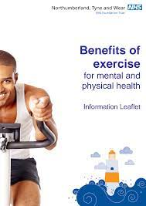
"If exercise were a pill, it would be one of the most cost-effective drugs ever invented" Dr Nick Cavill
It's medically proven that people who do regular physical activity have
30% lower risk of depression
30% lower risk of dementia
35% lower risk of coronary heart disease and stroke
50% lower risk of type 2 diabetes
50% lower risk of colon cancer
20% lower risk of breast cancer
83% lower risk of osteoarthritis
68% lower risk of hip fracture
https://www.cntw.nhs.uk/resource-library/the-benefits-of-physical-activity-for-mental-and-physical-health/

Slide 31
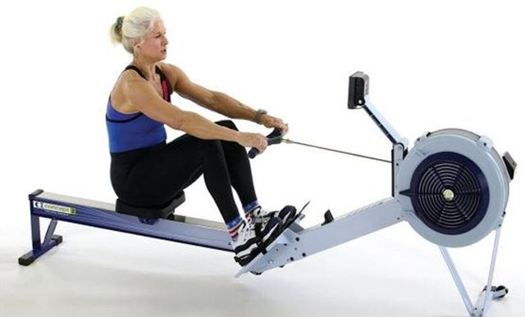
The best exercise for you is the one that you can do and enjoy
900+ members

Slide 32
Thank you
If there is a metabolic origin
there should be a metabolic solution?

Slide 33
Diagrammatic timeline towards T2D diagnosis
3
Diabetes diagnosis
3
2
2
Pre-diabetes diagnosis
1
1
Start of elevated insulin and path toward diabetes
Time (years/decades)

Slide 34
HEART DISEASE
ALZHEIMER’S
DIABETES
LOW TEST’E
PCOS
FATTY LIVER
SARCOPENIA
MIGRAINES
DEMENTIA
VISION LOSS
CANCER
STROKE
OSTEO
ARTHRITIS
BODY FAT
INSULIN RESISTANCE
testosterone
Polycystic ovarian syndrome
muscle loss
Prof Ben Bikman, Plagues of Prosperity Lecture, July 2018

